Slide 1
EarthLabs: Laboratory Courses in Earth and Environmental Science
Tamara Shapiro Ledley, Nick Haddad, Erin Bardar, Candace Dunlap, Jeff Lockwood, Betsy Youngman TERC, Cambridge MA
Karen McNeal, North Carolina State University
Julie Libarkin, Michigan State University
Kathy Ellins, University of Texas Austin
With
funding
from

Slide 2
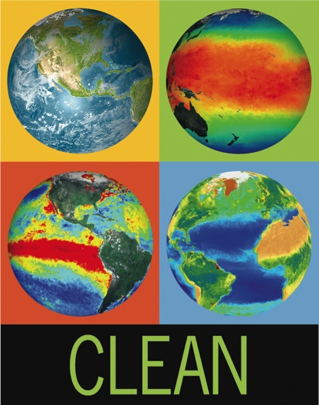
Educational Resources Addressing Climate Science and Earth System Science
Climate Literacy and Energy Awareness Network (CLEAN)
http://cleanet.org
Earth Exploration Toolbook
http://serc.carleton.edu/eet
EarthLabs
Teachers Guide http://serc.carleton.edu/earthlabs
Student Guide
http://serc.carleton.edu/eslabs

Slide 3
Climate Literacy and Energy Awareness Network (CLEAN) http://cleanet.org
>610 climate and energy educational resources
Activities, videos, visualizations
Grades 6-16
Reviewed for scientific accuracy, pedagogical effectiveness, and technical quality by 5-7 scientists and educators
Collection of educational resources in the Teaching Climate section of Climate.gov - www.climate.gov/teaching
Won 2014 Webby and People’s Choice award in Green Category
Gold et.al, Journal of Geoscience Education, 2012

Slide 4
The Earth Exploration Toolbook (EET)
http://serc.carleton.edu/eet
The EET is a collection of computer based activities that feature Earth science datasets and data analysis tools.
EET chapters provide step-by-step instructions for accessing and analyzing data to explore issues or concepts in Earth system science.
44 EET chapters
Ledley et al, Science, 2011

Slide 5
EarthLabs Climate Modules http://serc.carleton.edu/earthlabs/index.html
Project Components
Curriculum Development Professional Development Educational Research on Student Learning
Ellins et al, Journal of Geoscience Education, in press McNeal et al, Journal of Geoscience Education, in press
Notes:
EarthLabs provides rigorous and engaging Earth and environmental science labs and teacher professional development.
The EarthLabs collection comprises eight online modules that recognize the interconnectedness of Earth’s systems and climate forcing, and are designed to promote creativity, collaboration, and interest in cutting-edge science.
Each three-week EarthLabs module contains between six and nine rigorous sequenced laboratory experiences (learning activities) that include hands-on experiments, data analysis, and critical thinking (Ledley et al. 2012; McNeal et al., 2013). Learners examine satellite imagery, numerical data, computer visualizations, and data products to build quantitative skills that enable them to objectively evaluate scientific findings for themselves.
Key climate-related themes that cut across all three modules include:
the Earth system, with the complexities of its positive and negative feedback loops;
the range of temporal and spatial scales at which climate, weather, and other Earth system processes occur; and
the recurring question, “How do we know what we know about Earth’s past and present climate?” This question introduces students to proxy data, scientific instrumentation, and modeling.
A website with a student portal and a teacher portall. Web-based support. The EarthLabs Teacher’s Guide contains pedagogical and background information to support teacher use of each lab in their classroom, as well as a direct link to the student activities for the lab.

Slide 6
9 Modules comprised of 5-9 labs each in Earth science
Modules illustrate sequences for learning science concepts through data analysis and hands-on experiments.
Use satellite imagery, numerical data, and computer visualization software to explore Earth system processes
Include the use and development of quantitative skills that enable students to evaluate scientific results for themselves.

Slide 7
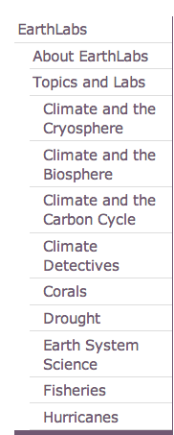
• Time requirement: 12 – 14 hours
• Each module uses a variety of instructional strategies
- readings
- videos, animations
- interactive visualizations
- hands-on lab investigations
- data analysis
- classroom discussions
http://serc.carleton.edu/earthlabs/index.html
Notes:
But…anyone can cherry-pick the specific pieces that they think will support a program they currently use.

Slide 8
EarthLabs website has 2 Parts
Teacher Side: http://serc.carleton.edu/earthlabs
Student Side: http://serc.carleton.edu/eslabs

Slide 9
EarthLabs Topics Brief Overview of Each Module

Slide 10
EarthLabs Climate Introduction
http://serc.carleton.edu/earthlabs/climate_intro/index.html

Slide 11
Lab Overviews http://serc.carleton.edu/earthlabs/cryosphere/lab_overviews.html

Slide 13
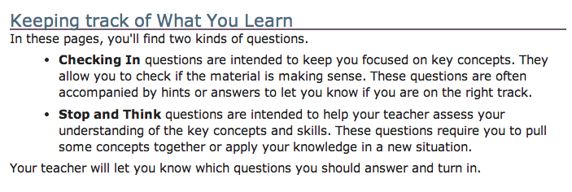
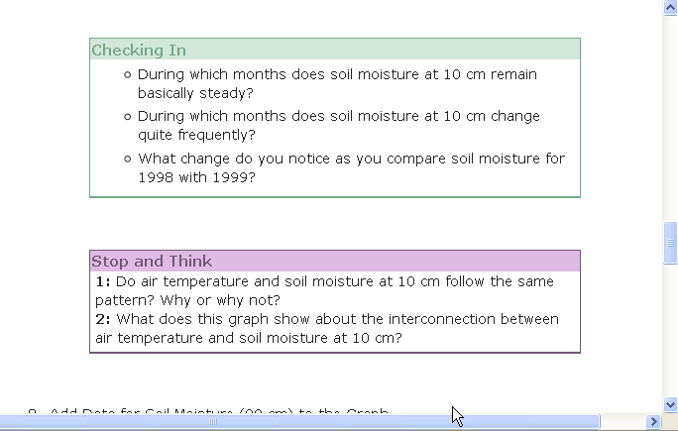

Slide 14
Explore the Climate and the Cryosphere Module
Key Questions
What is the cryosphere?
How and why does the cryosphere change over time?
What are the timescales associated with changes in the cryosphere?
How do climate and the cryosphere influence each other?
http://serc.carleton.edu/earthlabs/cryosphere/index.html

Slide 15
Explore the Climate and the Cryosphere Module
Teachers Guide
http://serc.carleton.edu/earthlabs/cryosphere/1.html
Student Portal
http://serc.carleton.edu/eslabs/cryosphere/index.html
Lab Overviews
The Cryosphere Labs
Getting to Know the Cryosphere
Earth’s Frozen Oceans
Land Ice
Climate History and the Cryosphere
Evidence of Recent Change
Future of the Cryosphere
Cryosphere Glossary

Slide 16
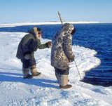
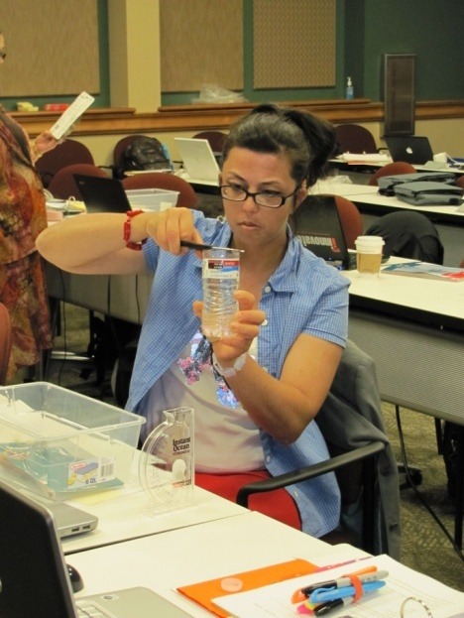
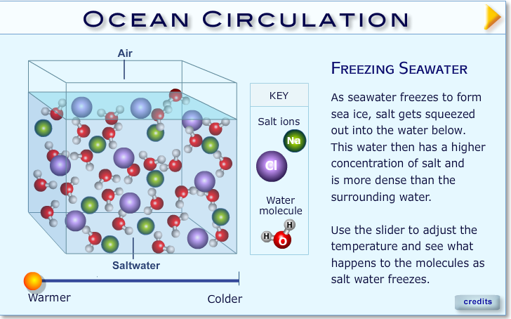
EarthLabs - Cryosphere
Getting to Know the Cryosphere
What are the components of the cryosphere
How climate and the cryosphere influence each other
Earth’s Frozen Oceans
How does sea ice form and how it influences ocean currents
How does sea ice thickness change over time
Land Ice
How do glaciers form
How do glaciers move

Slide 17
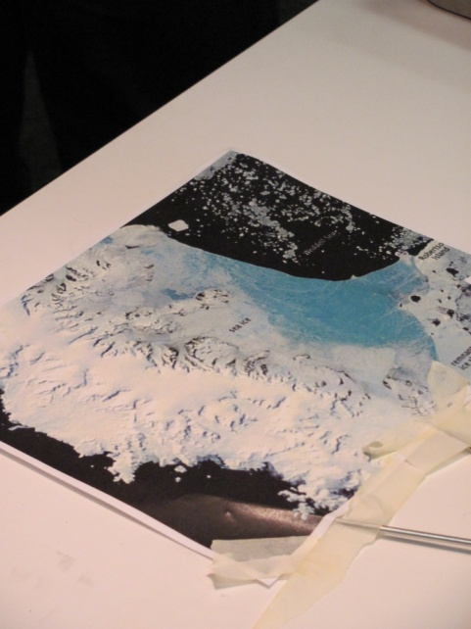
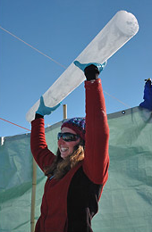
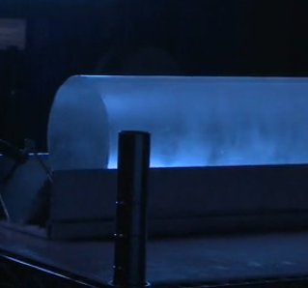
EarthLabs - Cryosphere
Climate History and the Cryosphere
Land ice
Processes and timescales involved in glaciation
How do scientists study glaciers
How temperture, glaciers, coastlines and sea level changed over the past 450,000 years
Evidence of Recent Change
Examine how land glaciers and sea ice have changed over the recent past
Future of the Cryosphere
Contemplate how climate will change in the future based on model results
Contemplate how changes in glaciers will contribute to sea level rise

Slide 18
Cognitive Challenges to Understanding Climate Change
Earth System Science
Understanding the interconnectedness of all of the components of the system
Changes in one component can have large and unanticipated impacts on other components
Change Over Time on Multiple and Embedded Time Scales
Daily, seasonal, annual, interannual, decadal, century, glacial, geologic…
Long-term change manifested as impact on shorter cycles

Slide 19
EarthLabs Educational Research
• How does the on-line EarthLabs curriculum assist students in developing understanding of temporal and spatial dynamics, system interactions, and conceptual knowledge of climate?
How do users engage with and navigate the on-line EarthLabs curriculum?

Slide 20
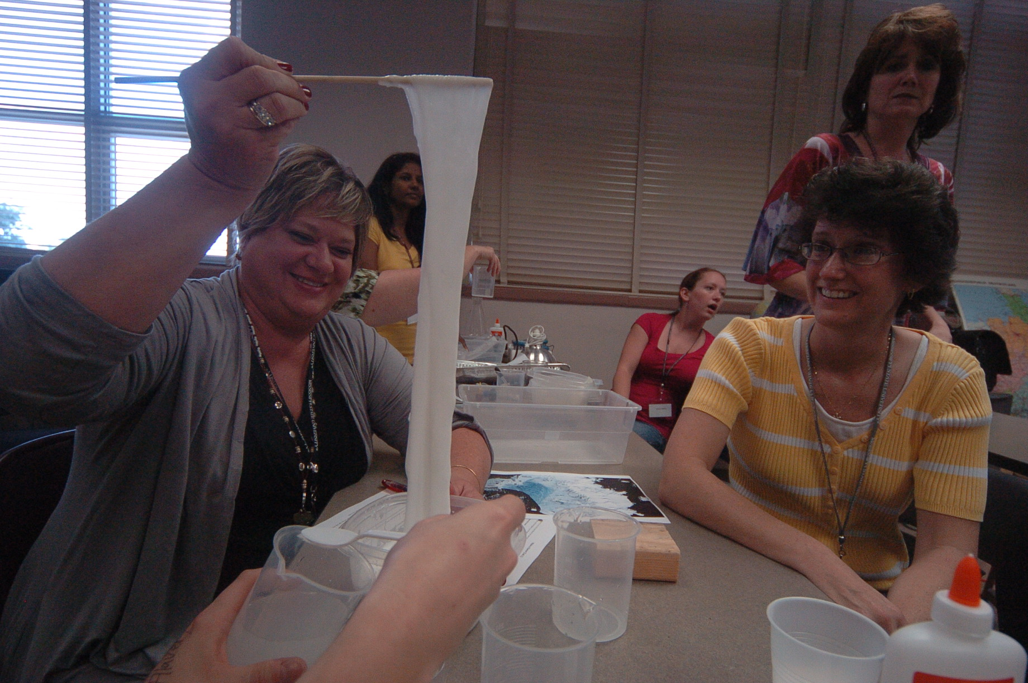
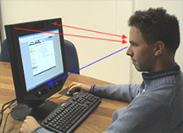
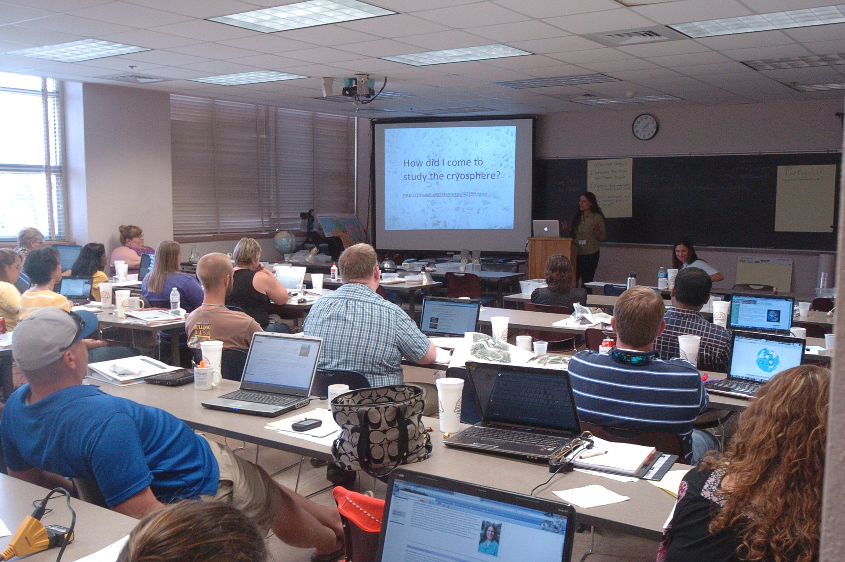
Populations & Methods
Teachers (n=8)
Post-implementation Interviews
Post-workshop surveys
Students (n=205)
Pre-post open-ended response surveys
Classroom observations
External Users (n=49)
Eye-tracking
Interviews
http://gettingsmart.com/cms/edreformer/new-report-highlights-real-teacher-retention-crisis-america/
http://www.uxmatters.com/mt/archives/2005/12/introduction-to-eyetracking-seeing-through-your-users-eyes.php
http://www.mnsu.edu/newstudent/seminar/
Notes:
Teacher M:F 1/7 C: 7; H: 1
Student M;F 92/111 C: 87; AA: 27; H: 78; A: 11; NA: 1; O: 1
External users M:F 18/31 C: 48; AA: 5; A: 7: NA: 1

Slide 21
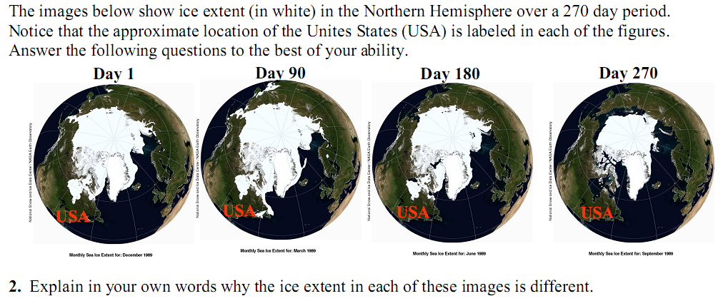
Example open-ended Cryosphere EarthLabs pre-post assessment
Notes:
Pre- and post-instruction systems thinking scores differed significantly on Wilcoxin signed ranks test (ρ = 0.08, Z = -1.74). In addition, paired student t-test analysis of pre-/post- conceptual understanding scores indicates statistically significant (ρ < 0.01) improvements where post-scores (M = 15.6) were higher than pre-scores (M =10.2).
Interestingly, students who completed only a portion of the labs exhibited no statistically significant improvements post-implementation (ρ > 0.05), whereas those engaged in all seven labs of the modules and spent nine in-class hours over the course of four weeks on these materials showed statistically significant improvements post-implementation (ρ < 0.05).

Slide 22
Student Methods: Systems Understanding Rubric
Symbol | Description | Points
Arrow | Actions/Processes (Usually a verb) | 1 point
Boxes | Inputs/Outputs (Usually a noun) | 2 points
Connections | Between Actions/Processes or Inputs/Outputs (Usually a conjunction) | 3 points

Slide 23
Example open-ended Cryosphere EarthLabs pre-post assessment
Student response: “The hemisphere is warming, causing ice to melt.”
Hemisphere
warms
9
Ice
melts
Notes:
Pre- and post-instruction systems thinking scores differed significantly on Wilcoxin signed ranks test (ρ = 0.08, Z = -1.74). In addition, paired student t-test analysis of pre-/post- conceptual understanding scores indicates statistically significant (ρ < 0.01) improvements where post-scores (M = 15.6) were higher than pre-scores (M =10.2).
Interestingly, students who completed only a portion of the labs exhibited no statistically significant improvements post-implementation (ρ > 0.05), whereas those engaged in all seven labs of the modules and spent nine in-class hours over the course of four weeks on these materials showed statistically significant improvements post-implementation (ρ < 0.05).

Slide 24
Expert response: “The images show the sea ice extent through the seasonal cycle. In the winter the sea ice extent would be the greatest. This is because there is no or little solar radiation over the region at that time of the year, causing air temperatures to be very low, resulting in a growth and expansion of sea ice at the surface of the ocean… The image for day 180 shows the sea ice extent reduced from the image for day 90 so that image shows the sea ice extent in the spring.”
Sunlight
Solar Radiation
is present
drops / is low
Air temps
rise
Air temps
36
drop
Ice temps
reach melting
Sea ice
grows
Ice
melts
Notes:
students scored below 20 points in pre-tests, but as high as 35 on post-tests, approaching the expert score of 36 points. Over half of the student respondents scored higher than 20 points in the post-assessment. Pre- and post-instruction systems thinking scores differed significantly on Wilcoxin signed ranks test (ρ = 0.08, Z = -1.74). In addition, paired student t-test analysis of pre-/post- conceptual understanding scores indicates statistically significant (ρ < 0.01) improvements where post-scores (M = 15.6) were higher than pre-scores (M =10.2). Interestingly, students who completed only a portion of the labs exhibited no statistically significant improvements post-implementation (ρ > 0.05), Self-assessed pre-/post- student confidence on the ESS module increased from an average of 1.20 to 1.94. Similar results were observed for the Cryosphere module, where students either maintained or increased their confidence level from 2.95 to 3.60.

Slide 25
Student Methods: Rubric #2 – Conceptual Understanding
Level 0. Simple restating of the question.
Level 1. Statement of a single correct fact.
Level 2. Statement of multiple correct facts.
Level 3. A. Statement of multiple correct facts, with a single connection between facts. OR B. Statement of multiple correct facts, with multiple connections between facts. Misconceptions equal to or dominate over scientific conceptions.
Level 4. Statement of multiple facts, with multiple connections between facts. Misconception(s) present, but scientific conceptions dominate.
Level 5. Statement of multiple facts, with multiple connections between facts. Misconceptions not present within a story that is cohesive; misconceptions about concepts outside of the core message may be present.

Slide 26
Pre-post student response rubric scores
“Explain in your own words why the ice extent of these images is different”
Pre-post p <0.05
Notes:
students scored below 20 points in pre-tests, but as high as 35 on post-tests, approaching the expert score of 36 points. Over half of the student respondents scored higher than 20 points in the post-assessment. Pre- and post-instruction systems thinking scores differed significantly on Wilcoxin signed ranks test (ρ = 0.08, Z = -1.74). In addition, paired student t-test analysis of pre-/post- conceptual understanding scores indicates statistically significant (ρ < 0.01) improvements where post-scores (M = 15.6) were higher than pre-scores (M =10.2). Interestingly, students who completed only a portion of the labs exhibited no statistically significant improvements post-implementation (ρ > 0.05), Self-assessed pre-/post- student confidence on the ESS module increased from an average of 1.20 to 1.94. Similar results were observed for the Cryosphere module, where students either maintained or increased their confidence level from 2.95 to 3.60.

Slide 27
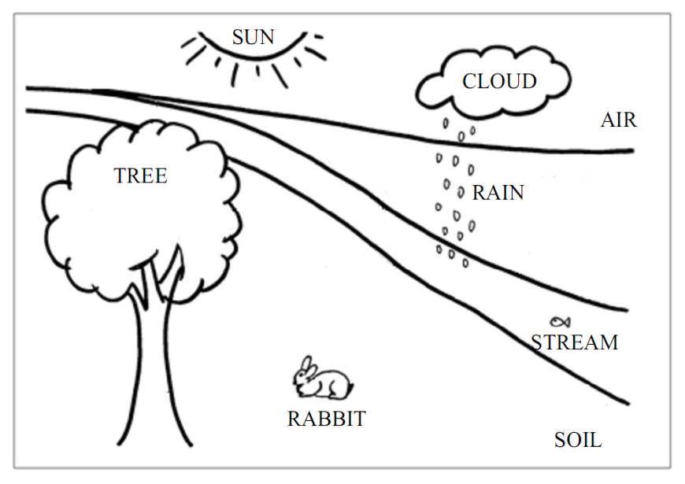
“The following diagram represents a region in the continental United States. Draw in and label arrows to represent ALL of the important processes that move or change energy, water, or chemicals in this region”.
Notes:
students showed significant increases in the number of arrows drawn (pre < 3, post > 5). Furthermore, paired student t-test analyses indicated statistically significant differences (ρ < 0.05) on pre-/post- mean scores using the systems rubric (Table 3; pre-M = 8.72, post-M = 12.81). When expert geoscientists (n=2) were asked to complete the same task, an average of 10 arrows were drawn and an average score of 34 was achieved

Slide 28
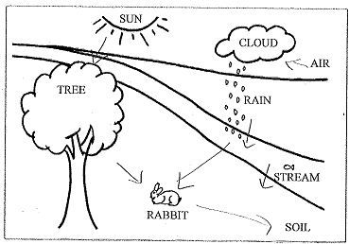
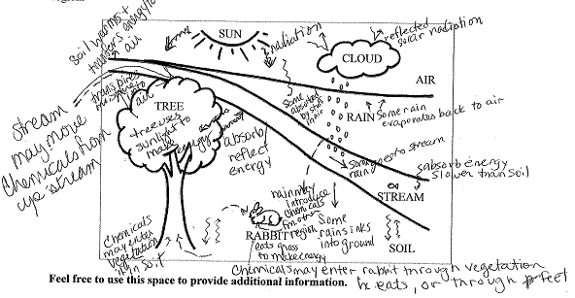
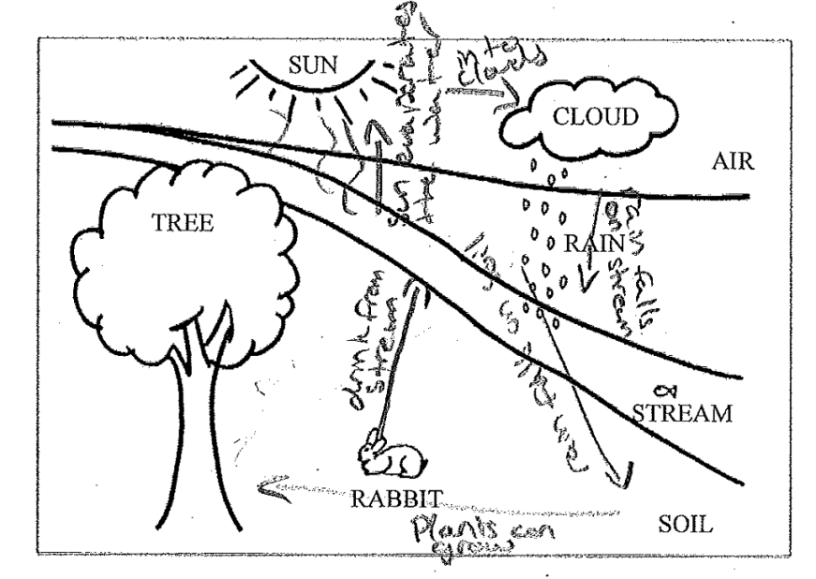
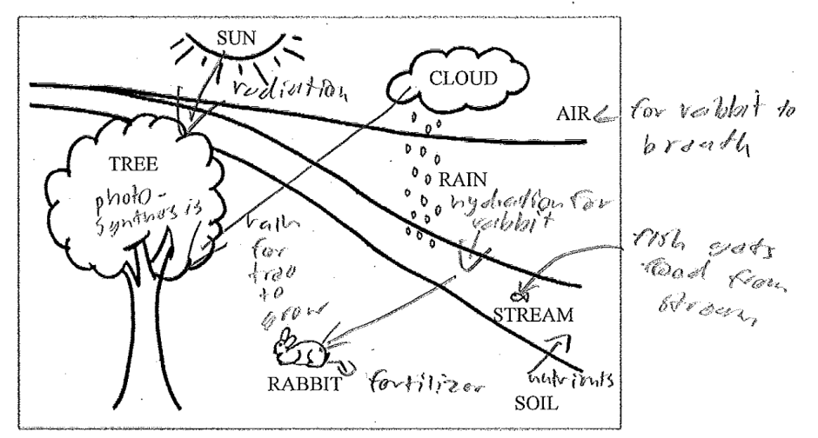
Pre
Systems Understanding
Teacher
Expert = 34
Expert
Score
Pre
Post
Post
Number of Arrows Drawn
Expert = 10
Teacher
Score
Pre
Post
Notes:
students showed significant increases in the number of arrows drawn (pre < 3, post > 5). Furthermore, paired student t-test analyses indicated statistically significant differences (ρ < 0.05) on pre-/post- mean scores using the systems rubric (Table 3; pre-M = 8.72, post-M = 12.81). When expert geoscientists (n=2) were asked to complete the same task, an average of 10 arrows were drawn and an average score of 34 was achieved

Slide 29
Please describe and define
The Cryosphere in your own words
Systems Understanding
Student Example
Pre: “I don’t know, sorry.”
Post: “The sphere with ice, snow, sleet, etc.”
Pre-instruction = 42% “I don’t know”
Post-instruction = 18% “I don’t know”
Pre
Post
Pre-instruction = 33% “ice”
Post-instruction = 57% “ice”
Paired Student’s t-test p < 0.05
N = 163
Notes:
students showed significant increases in the number of arrows drawn (pre < 3, post > 5). Furthermore, paired student t-test analyses indicated statistically significant differences (ρ < 0.05) on pre-/post- mean scores using the systems rubric (Table 3; pre-M = 8.72, post-M = 12.81). When expert geoscientists (n=2) were asked to complete the same task, an average of 10 arrows were drawn and an average score of 34 was achieved

Slide 30
Please describe and define
Earth system science in your own words
Conceptual Understanding
Student Example
Pre: “The research of the way that the Earth operates. This show us how the earth is changing as a whole.”
Teacher
Score
Post: “The work of geography such as biosphere, pedosphere, atmosphere, and hydrosphere used to find information and solve facts for future use and help us find out more about the way our planet works”
Pre
Post
Paired Student’s t-test p < 0.05
N = 163
Notes:
students showed significant increases in the number of arrows drawn (pre < 3, post > 5). Furthermore, paired student t-test analyses indicated statistically significant differences (ρ < 0.05) on pre-/post- mean scores using the systems rubric (Table 3; pre-M = 8.72, post-M = 12.81). When expert geoscientists (n=2) were asked to complete the same task, an average of 10 arrows were drawn and an average score of 34 was achieved

Slide 31
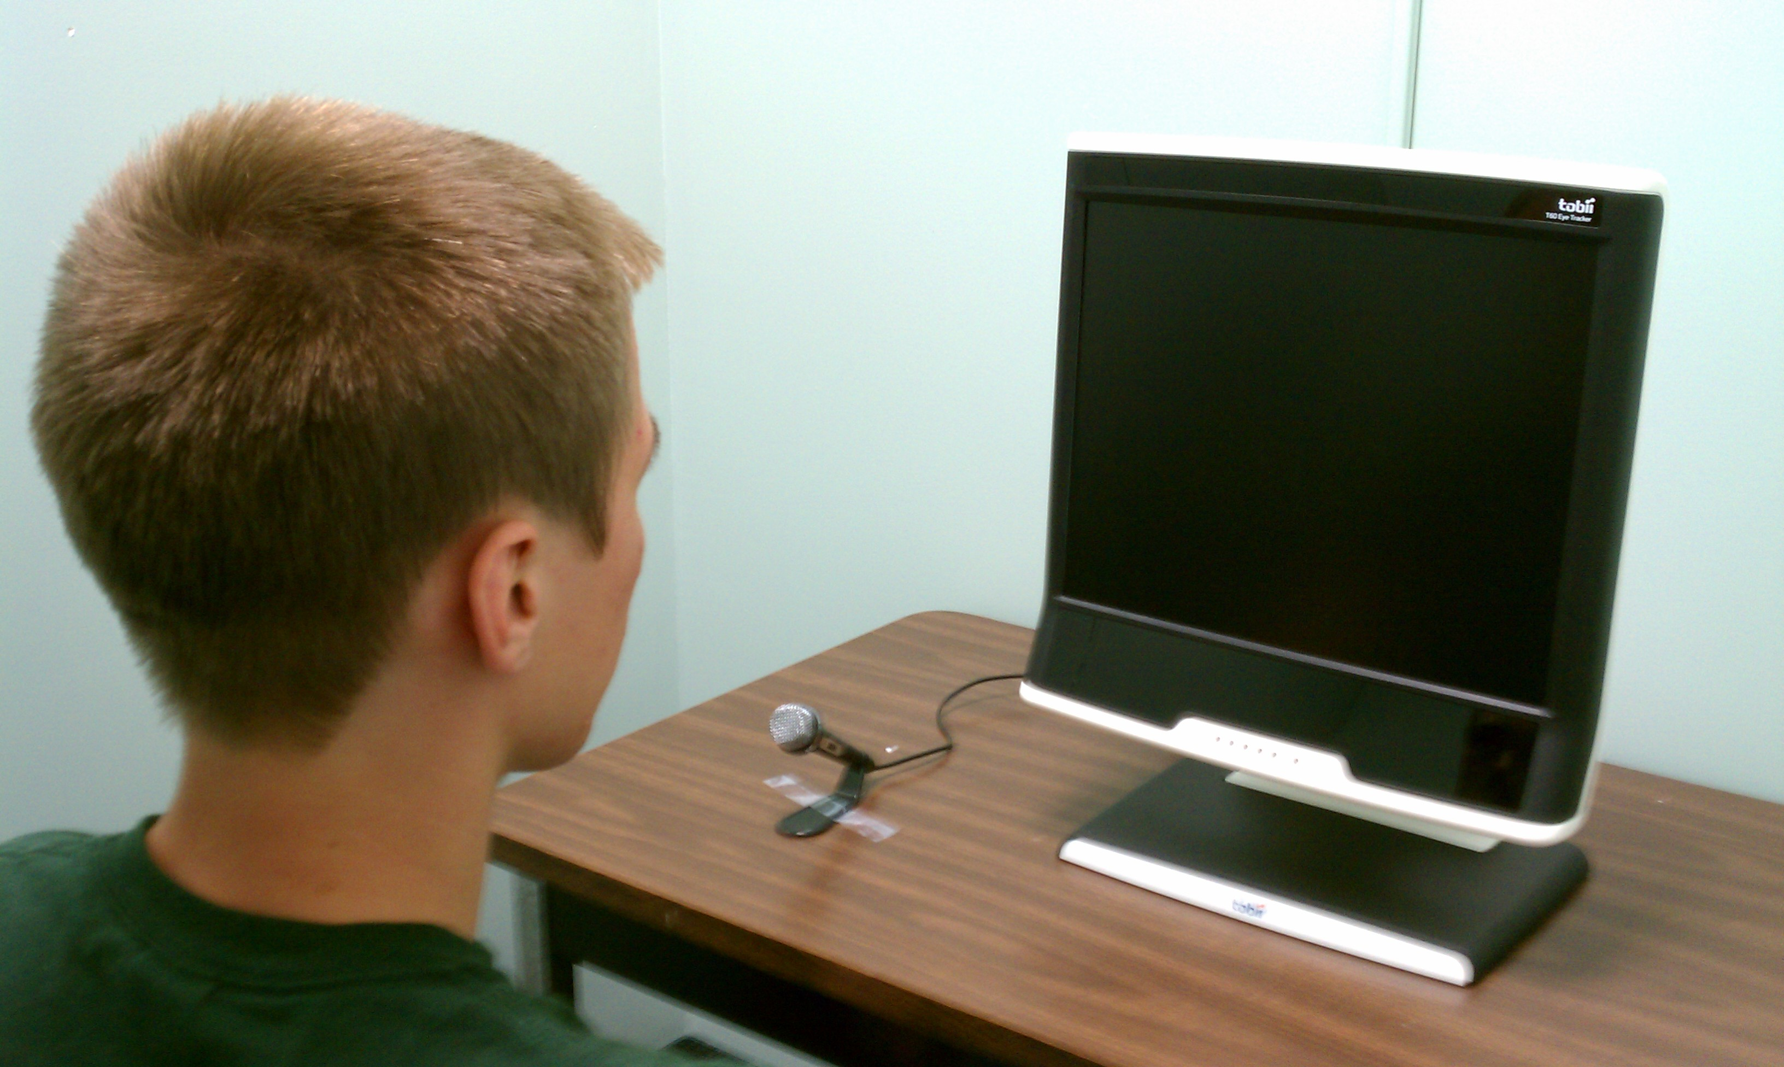
Methods: Eye-tracking studies
Pre-Study Measures
Color-blindness
Climate change conceptions
Demographics

Slide 32
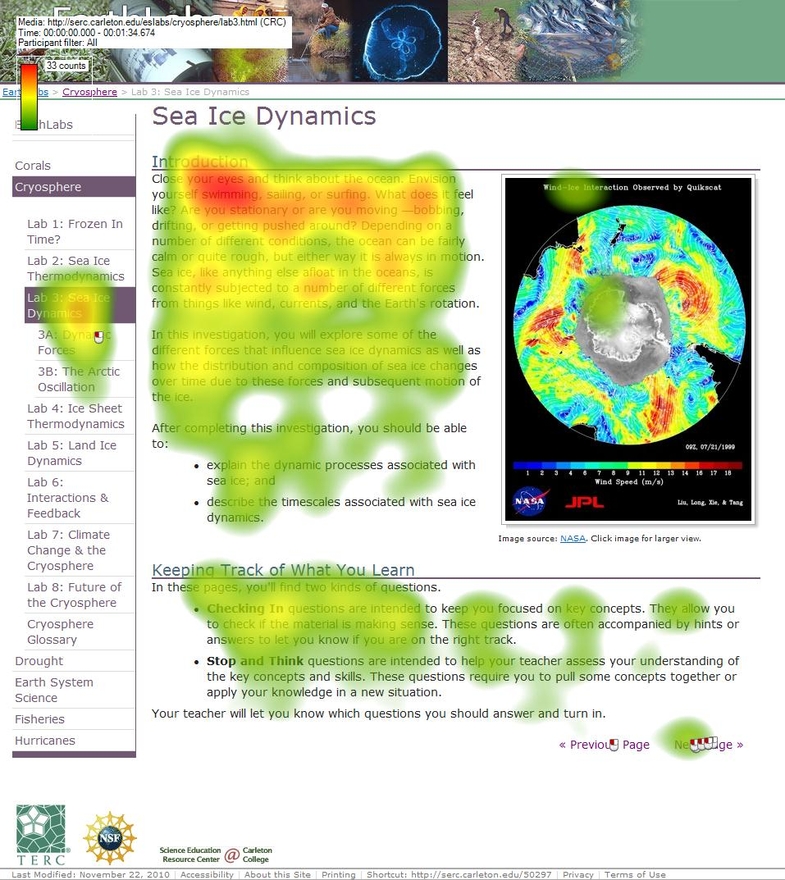
Time to complete - 23 and 32 minutes
engaged less with images than with text
difficulty engaging with some materials posted on external sites
Notes:
Overall, data indicate that students spent between 23 and 32 minutes completing the lab, engaged less with images than with text, and had difficulty engaging with some materials posted on external sites, such as graphs depicting change in climate indices over time. Each of these findings was also observed in student interactions with other lab materials, indicating that: 1) labs are sufficiently engaging for students; and 2) materials hosted by external sites (e.g., NASA, NOAA) may need modification before students can engage effectively with them.

Slide 33
Purple path is a participant with significant attention.
Blue path is cursory and is typical of most participants.
Notes:
Two individual gaze paths for Blue Marble site (external link on EarthLabs ESS module).

Slide 34
Students had difficulty knowing where to look on complex scientific graphs/figures
Notes:
Two individual gaze paths for Blue Marble site (external link on EarthLabs ESS module).

Slide 35
Conclusions
Students’ SYSTEMS UNDERSTANDING and CONCEPTUAL UNDERSTAND significantly improved after exposure to EarthLabs modules, although students did not reach mastery levels on par with expert responses.
Classroom observations combined with eye-tracking measures of external users indicate that the EarthLabs modules were ENGAGING TO USERS.
The EarthLabs CURRICULUM-RESEARCH model is an example of how research can be used to inform curriculum development.

Slide 36
Educational Resources Addressing Climate Science and Earth System Science
Climate Literacy and Energy Awareness Network (CLEAN)
http://cleanet.org
Earth Exploration Toolbook
http://serc.carleton.edu/eet
EarthLabs
Teachers Guide http://serc.carleton.edu/earthlabs
Student Guide
http://serc.carleton.edu/eslabs
CONTACT: Tamara Shapiro Ledley, Tamara_Ledley@terc.edu, 617-873-9658

